Slide 1

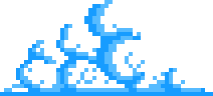

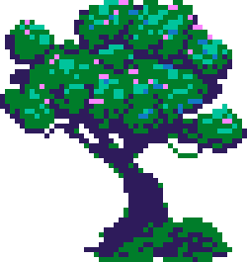
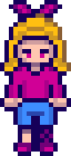
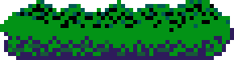
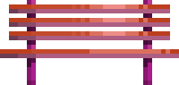
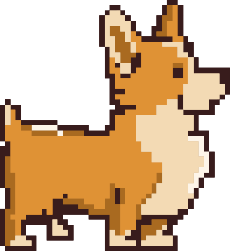
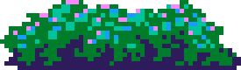
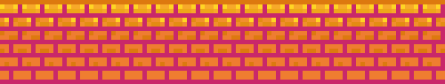
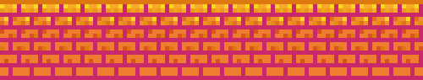
GAME

Slide 2
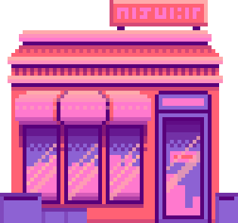

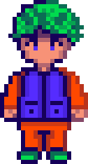
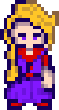
Welcome To Our Presentation
Title: TypeCaster Battle: AI-Adaptive Typing Game
Subtitle: A Dynamic Difficulty Adjustment System using Python & Machine Learning
OUR TEAM
Ahmed Haitham
Wed Ahmed
Ruqayah Alaa

Slide 3
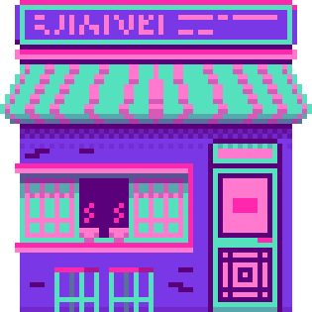
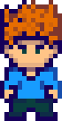
The Problem & The Solution
Objective: Most typing games have static difficulty levels (Easy, Medium, Hard) that don't fit every player.
The Problem: A static "Hard" mode might be too fast for some but too slow for others. Players either get bored or frustrated.
Our Solution: An "Intelligent" game that watches you play. It analyzes your typing speed (WPM) and accuracy in real-time to generate words that are *exactly* challenging enough for you.

Slide 4
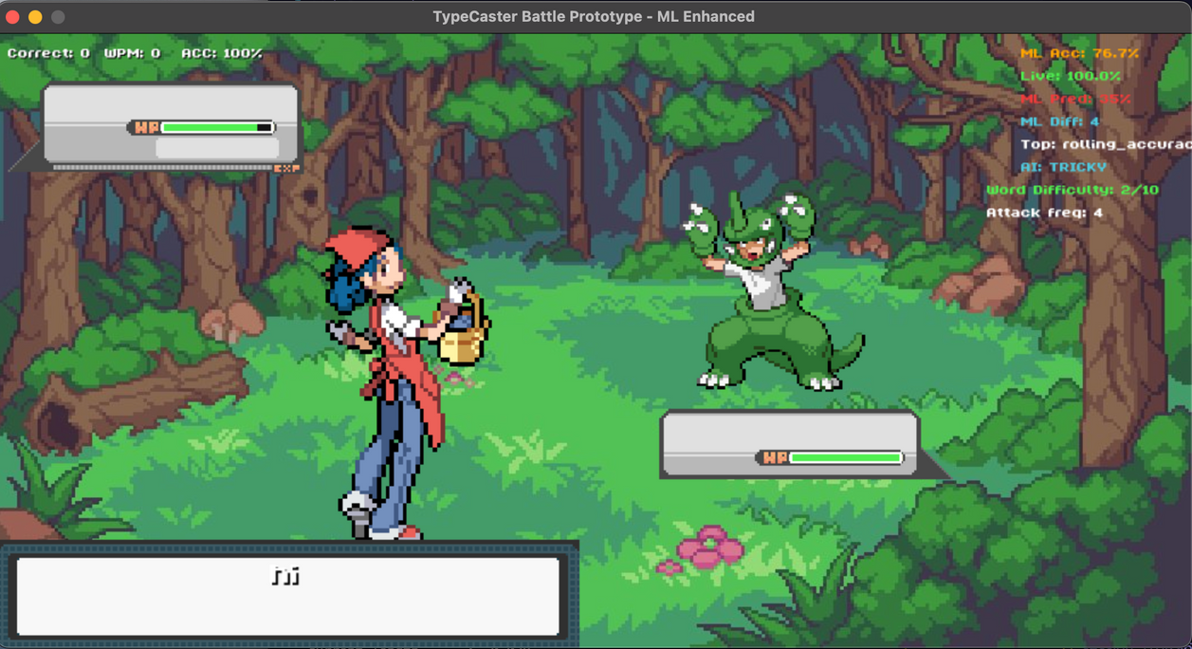

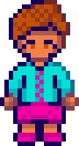
Game Concept & Gameplay
Genre: RPG-Style Typing Battle.
Core Loop.
1
2
Attack: Type the displayed word correctly to damage the enemy.

Slide 5
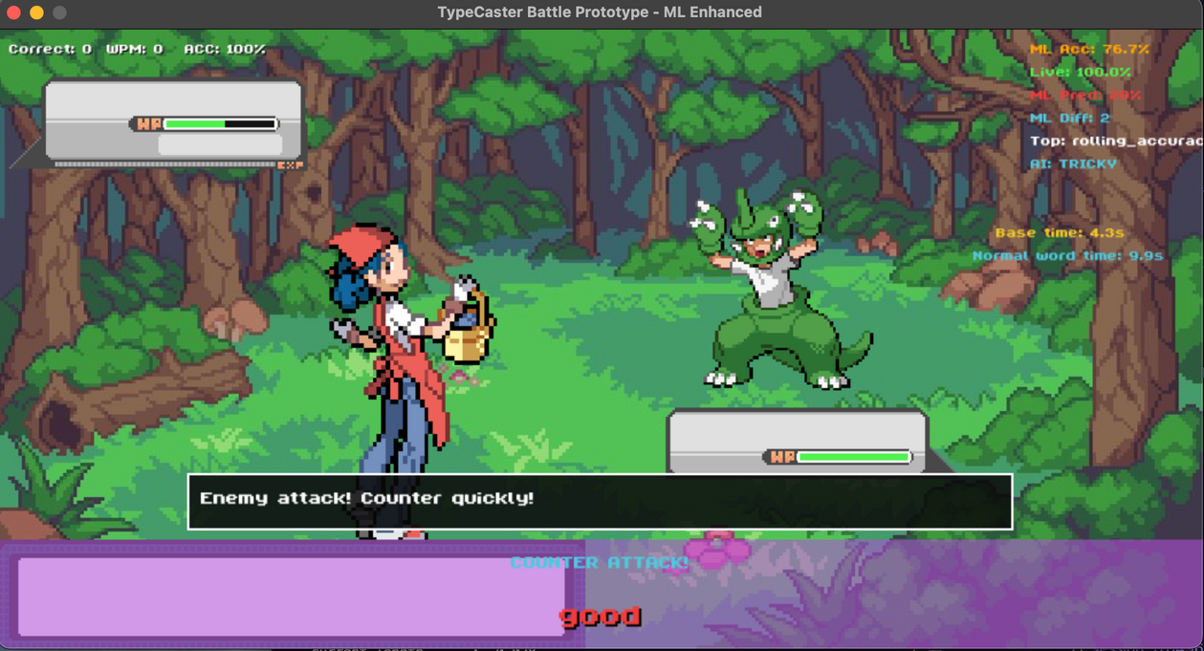
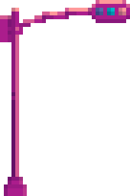
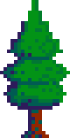

Defend: When the enemy attacks, you must type a "Counter Word" quickly to block damage.
3
The Twist: The enemy doesn't just have more health; it gets "smarter." As you play better, the enemy starts using trickier words (e.g., words with 'Z' or 'X', or capitalizing letters like PyThOn).
4

Slide 6
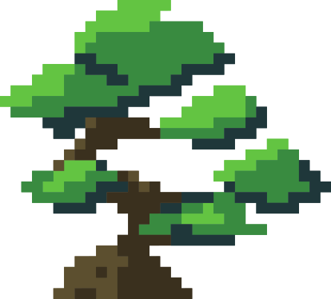
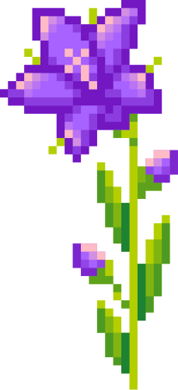

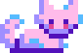
System Architecture (How it Works)
1- The "Director" (Rule-Based AI):
Watches for specific physical mistakes.
-Example:If you keep missing keys on the left side of the keyboard (Q, W, E, A, S), it intentionally gives you more "Left-Hand Dominant" words to force you to practice.
2-The "Predictor" (Machine Learning):
Uses Logistic Regression (Scikit-Learn) to predict if you will fail the *next* word.
If it predicts you will succeed easily (>80% probability), it raises the difficulty immediately.

Slide 7
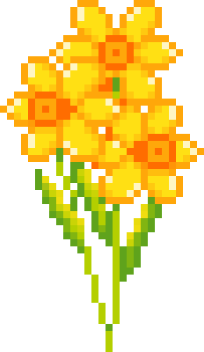
The "Brain" of the Game (Libraries Used)
1-Pygame: Handles the graphics, game loop, and input detection.
2- Scikit-Learn: The core AI library. We use it to train a Logistic Regression model on the player's past performance.
3- NumPy: Used for efficient numerical calculations (handling arrays of game data for the AI).
4-JSON: Used for "Memory." The game saves every session, so the AI has more data to learn from every time you play.

Slide 8
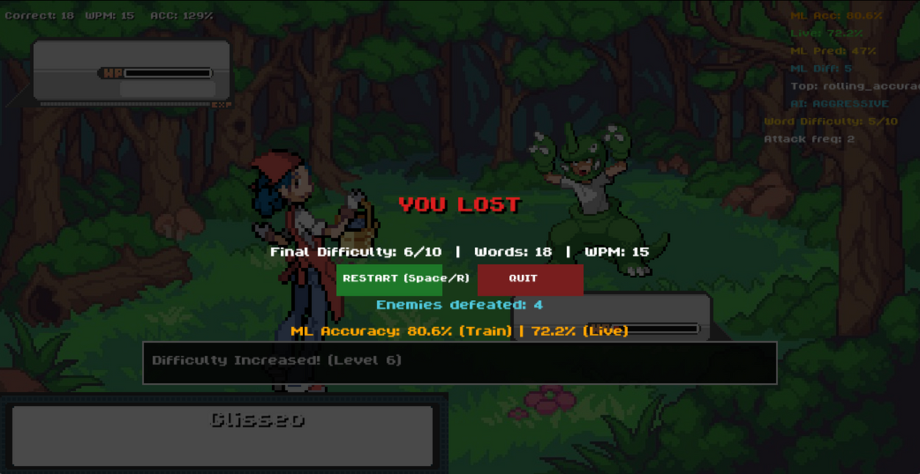
How We Measure Difficulty
The game doesn't just guess difficulty; it calculates it mathematically using our WordLibrary Class:
Word Length: Longer words = Higher score.
Rare Letters: Words with Z, X, Q, J add difficulty points.
Keyboard Row Jumps: Words that force you to jump between the top and bottom rows (e.g., "Muzzy") are scored higher than "Home Row" words (e.g., "Salsa").
Result: A difficulty score from 1-10 is assigned to every word dynamically.
The game doesn't just guess difficulty; it calculates it mathematically using our WordLibrary Class:
Word Length: Longer words = Higher score.
Rare Letters: Words with Z, X, Q, J add difficulty points.
Keyboard Row Jumps: Words that force you to jump between the top and bottom rows (e.g., "Muzzy") are scored higher than "Home Row" words (e.g., "Salsa").
Result: A difficulty score from 1-10 is assigned to every word dynamically.

Slide 9
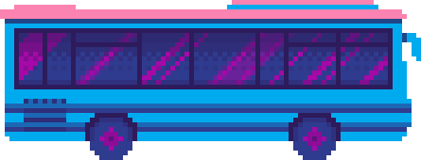
Challenges & Future Improvements
Challenge: Balancing the AI so it doesn't become *too* hard too quickly. We implemented a "cooling off" period where difficulty drops if the player fails 3 times in a row.
Future Improvement: We could implement a Neural Network to detect more complex patterns, like if a player struggles with specific letter combinations (e.g., "th" or "ing").

Slide 10
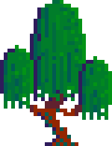
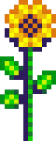
THANK YOU

